Slide 1
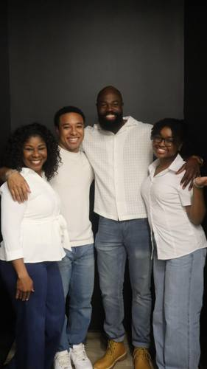
USED TO BE
A Story of Black Family,
Resilience & Healing
SPONSORSHIP OPPORTUNITY DECK
Written & Produced by Nia Calise Lewis
Directed by Erran Booker
Executive Producer: Dr. Shana D. Lewis
Presented by Off CNTR Productions
NOW IN POST-PRODUCTION
FESTIVAL BOUND

Slide 2
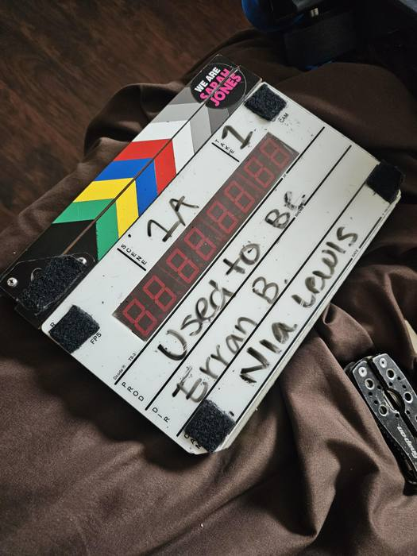
LOGLINE
THE
FILM
Jayla, a 16-year-old Black girl in Houston, must confront her father's abandonment when her family faces eviction — discovering that healing, forgiveness, and second chances are possible even in the hardest circumstances.
WHY IT MATTERS
1. Nuanced, authentic portrait of a working-class Black family navigating real trauma
2. Centers mental health, addiction recovery & intergenerational healing
3. Counters harmful media stereotypes — shows Black fathers as capable of change
4. Female-led story centering a Black teenage girl's emotional journey
5. Set in Houston — giving voice to the South's underserved communities
2.5 DAYS ON LOCATION | HOUSTON, TX

Slide 3
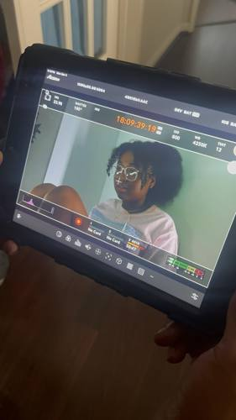
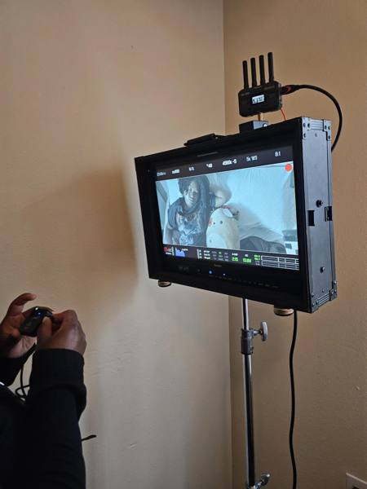
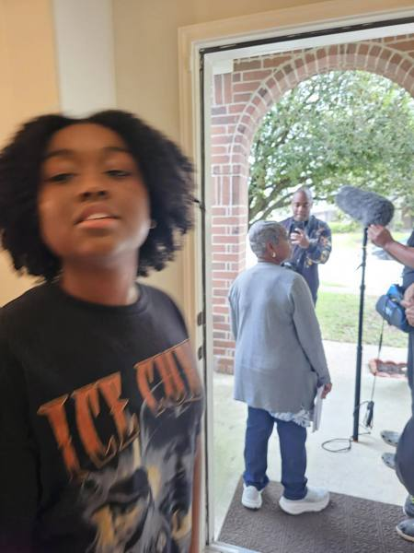
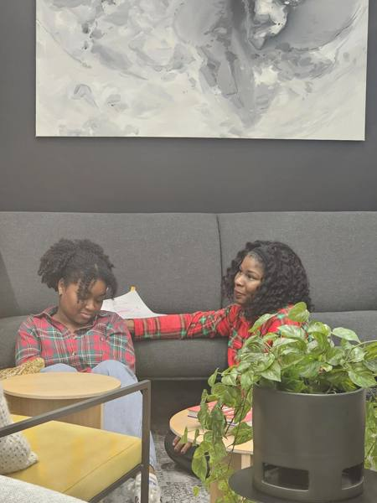
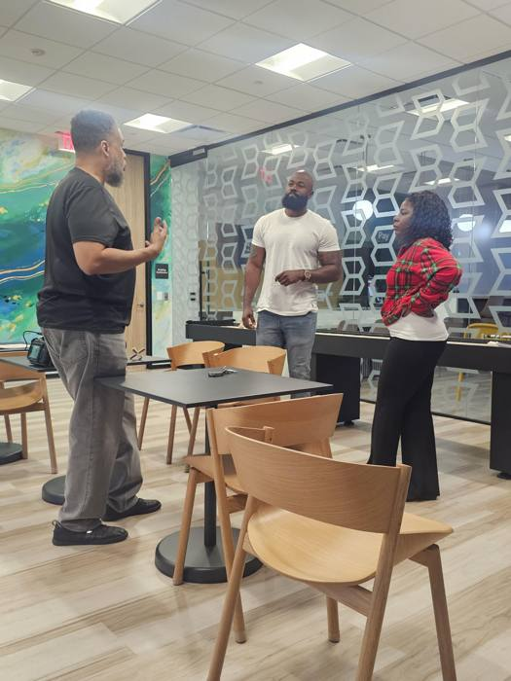
BEHIND THE SCENES | 2.5 DAYS OF PRODUCTION
Director Monitor
Director at Video Village
Door Scene — BTS
Jayla & Keisha — Scene
Erran Booker + Cast Rehearsal
Cast: Keisha · DJ · Dorian · Jayla

Slide 4
WHERE WE ARE — AND WHERE WE'RE GOING
COMPLETE
IN PROGRESS
NEXT PHASE
PRE-PRODUCTION
& FILMING
POST-PRODUCTION
FESTIVAL
CIRCUIT
2.5 days of principal photography in Houston, TX. Full cast, crew, and professional equipment.
Editing, color grading, sound design, score, and final mix. Sponsorship needed to complete.
Submissions to ABFF, Sundance, Urbanworld, BlackStar, WorldFest & HBCU screenings.
→
→
YOUR SPONSORSHIP COMPLETES THIS FILM AND GETS IT TO THE WORLD.

Slide 5
THE MARKET OPPORTUNITY
Black audiences are one of America's most powerful, brand-loyal, and underserved demographics.
$1.6T
87%
3.5x
200+
Black Consumer
Spending Power
Support brands that
reflect their values
More likely to engage
with Black-led content
Guests at the
Houston Red Carpet
World Premiere
Sources: Nielsen · McKinsey & Company · Pew Research Center

Slide 6
THEMATIC PILLARS YOUR BRAND CAN STAND BEHIND
Black Family Representation
Mental Health & Recovery
Nuanced, hopeful portrayal of a Black family navigating hardship — countering harmful media stereotypes.
Dorian's sobriety journey and therapy arc normalizes help-seeking in Black communities.
Financial Fragility & Housing Security
Single Mothers & Resilience
Eviction, empty refrigerators, utility shutoffs — the real consequences of wage gaps and underemployment.
Keisha works two jobs and holds her family together — a universal story of strength familiar to millions.
Youth Emotional Wellness
Intergenerational Healing
Jayla's breakthrough models emotional literacy and healing for teens navigating family trauma.
A father's return and family forgiveness — a powerful message about second chances and breaking cycles.

Slide 7
WHY FINANCIAL BRANDS
BELONG HERE
01
Single Mother Reality
Keisha works TWO jobs to keep the family housed — a story lived by millions of Black single mothers. Banks, insurance companies, and financial brands can align with this truth.
02
Underemployment & Financial Fragility
Eviction, utility shutoffs, empty fridge — consequences of wage gaps in Black communities. Financial literacy programs and emergency savings products have a home here.
03
Your Brand as the Solution
Align with financial wellness, economic equity, and community investment. From auto dealers to accounting firms — if you serve Black families, this story is your story.
04
Trust Through Authenticity
87% of Black consumers prefer brands that reflect their lived experience. This is not advertising. This is investment in community trust.
Keisha & Jayla — Bedroom Scene (Production Still)

Slide 8
BRANDS THAT SERVE BLACK FAMILIES BELONG HERE
Banks & Credit Unions
Insurance & Healthcare
Financial Wellness · Housing Stability
Family Protection · Mental Health Access
Keisha's eviction arc and two-job struggle speaks directly to financial fragility in Black households. Align with emergency savings, financial literacy, and community investment programs.
Dorian's sobriety and therapy journey plus Keisha's overextended sacrifice create a natural entry point for life insurance, health plans, and EAP providers.
Community banks · Credit unions · Fintech apps · Housing nonprofits
Life insurance · Health plans · Pharma · EAP providers
Retail
Accounting, Payroll & Professional Services
Black Family Values · Everyday Community
Economic Empowerment · Business Growth
The Johnson family's story reflects the everyday realities of your core customer. Authentic sponsorship here signals cultural competency and genuine community investment.
Small business owners, entrepreneurs, and professional firms that serve Black communities find authentic alignment with a film about resilience, work ethic, and financial survival.
Auto dealerships · Furniture · Clothing · Grocery & household brands
Accounting firms · Payroll companies · Tax services · Law firms

Slide 9
SPONSORSHIP TIERS
Red Carpet World Premiere · June 20, 2026 · The Match, Houston · 200+ Guests
PRESENTING
EXECUTIVE
COMMUNITY
Title Sponsor
Co-Sponsor
Supporting Sponsor
$5,000
$1,500
$500
"Presented by [Brand]" in all materials
Logo on title card & end credits
Co-branded press releases & social
VIP premiere speaking opportunity (7 min or panel inclusion)
VIP Premiere reserved seating for 8
Product placement scene integration
Exclusive BTS content for brand use
Insert in VIP bags
Logo on film poster (if applicable)
Branded festival presence & signage
3 dedicated social media features
Product placement integration
VIP Premiere night reserved seating for 3
Speaking Opportunity (5 min)
Inclusion in all press materials
Insert in VIP bags
Logo placement
Social media brand mention
VIP Premiere night attendance for 2
Film screening rights (1 event)
Speaking Opportunity (3 min)
Insert in VIP bags
$250
FILM FRIEND
Name listed in premiere program · Social media thank-you post · 1 VIP Admission premiere ticket
$100
PATRON
Name listed in premiere program · 1 VIP Admission premiere ticket · Digital certificate of support
Community Supporter
Individual Supporter

Slide 10
FESTIVAL CIRCUIT — WHERE YOUR BRAND TRAVELS
Every festival submission costs money. Every accepted screening costs travel. Your sponsorship makes this journey possible — and your brand travels with it.
Sundance Film Festival
PRESTIGE
American Black Film Festival (ABFF)
IDEAL FIT
Park City, Utah | January · Sub: ~$55 (early) – $85 (late) · Est. Travel: ~$1,500–$2,500
Miami Beach, Florida | May 27–31, 2026 · Sub: ~$45–$75 · Est. Travel: ~$1,200–$2,000
The most prestigious independent film festival in the US. Short films eligible for Oscar qualification. A selection here launches careers.
The premier festival for Black filmmakers and stories. Features the prestigious HBO Short Film Award. Academy Award-qualifying. Ideal platform for Used to Be.
Urbanworld Film Festival
STUDENT CATEGORY
BlackStar Film Festival
OSCAR QUALIFYING
WorldFest-Houston International Film Festival
HOME COURT
New York City | November
Sub: ~$40–$65 · Travel: ~$1,500–$2,500
Philadelphia, PA | Summer
Sub: ~$25–$45 · Travel: ~$1,000–$1,800
Houston, Texas | Spring
Sub: ~$45–$80 · Travel: LOCAL
NYC's largest competitive festival for multicultural storytellers. Features a "Best Young Creators" category (ages 18–25) — a perfect fit for Nia.
Oscar & BAFTA-qualifying festival celebrating Black, Brown & Indigenous filmmakers. Known for elevating emerging voices and experimental storytelling.
Houston's own international festival — the home court advantage. Includes a Student Short Film category. A Remi Award winner gets Cinemark screenings.
Estimated Festival Budget (5 Festivals): Submission Fees ~$250–$350 · Travel & Lodging ~$5,000–$8,000 · Total Est. ~$5,500–$9,000

Slide 11
RED CARPET WORLD PREMIERE
JUNE 20, 2026
RED CARPET WORLD PREMIERE
THE MATCH | HOUSTON, TEXAS
★ Sponsor Recognition
◈ Red Carpet Presence
◉ Festival Circuit
Your brand highlighted by name during the live premiere program before 200+ Houston guests — press, community leaders, VIP attendees & supporters.
Logo on premiere signage, programs, and all event materials distributed to 200+ attendees on the night.
After Houston, the film heads to ABFF, Sundance, Urbanworld & more — your sponsorship travels with it.

Slide 12
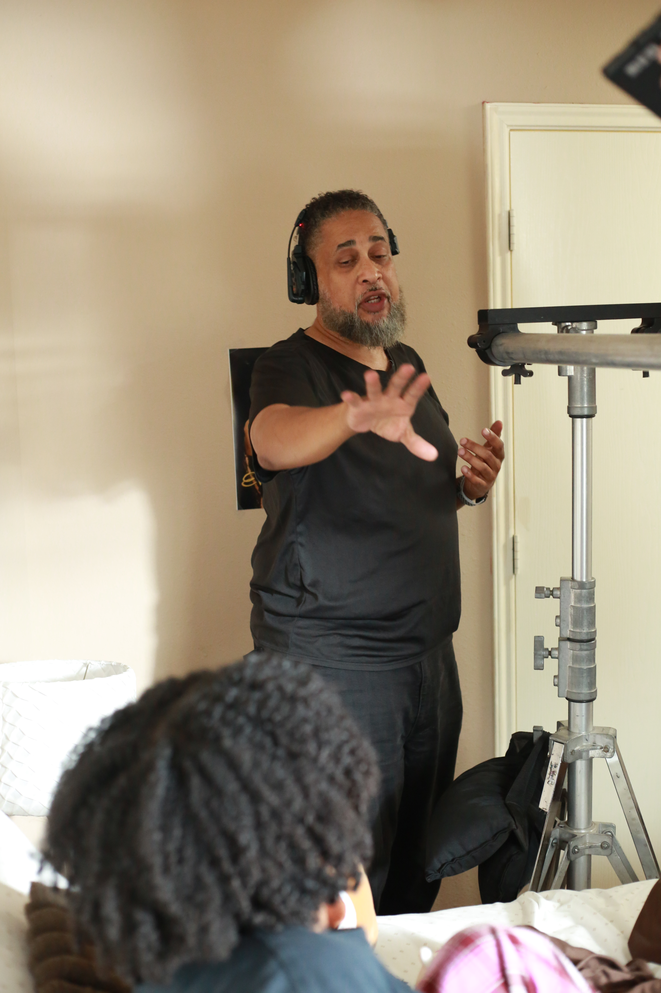
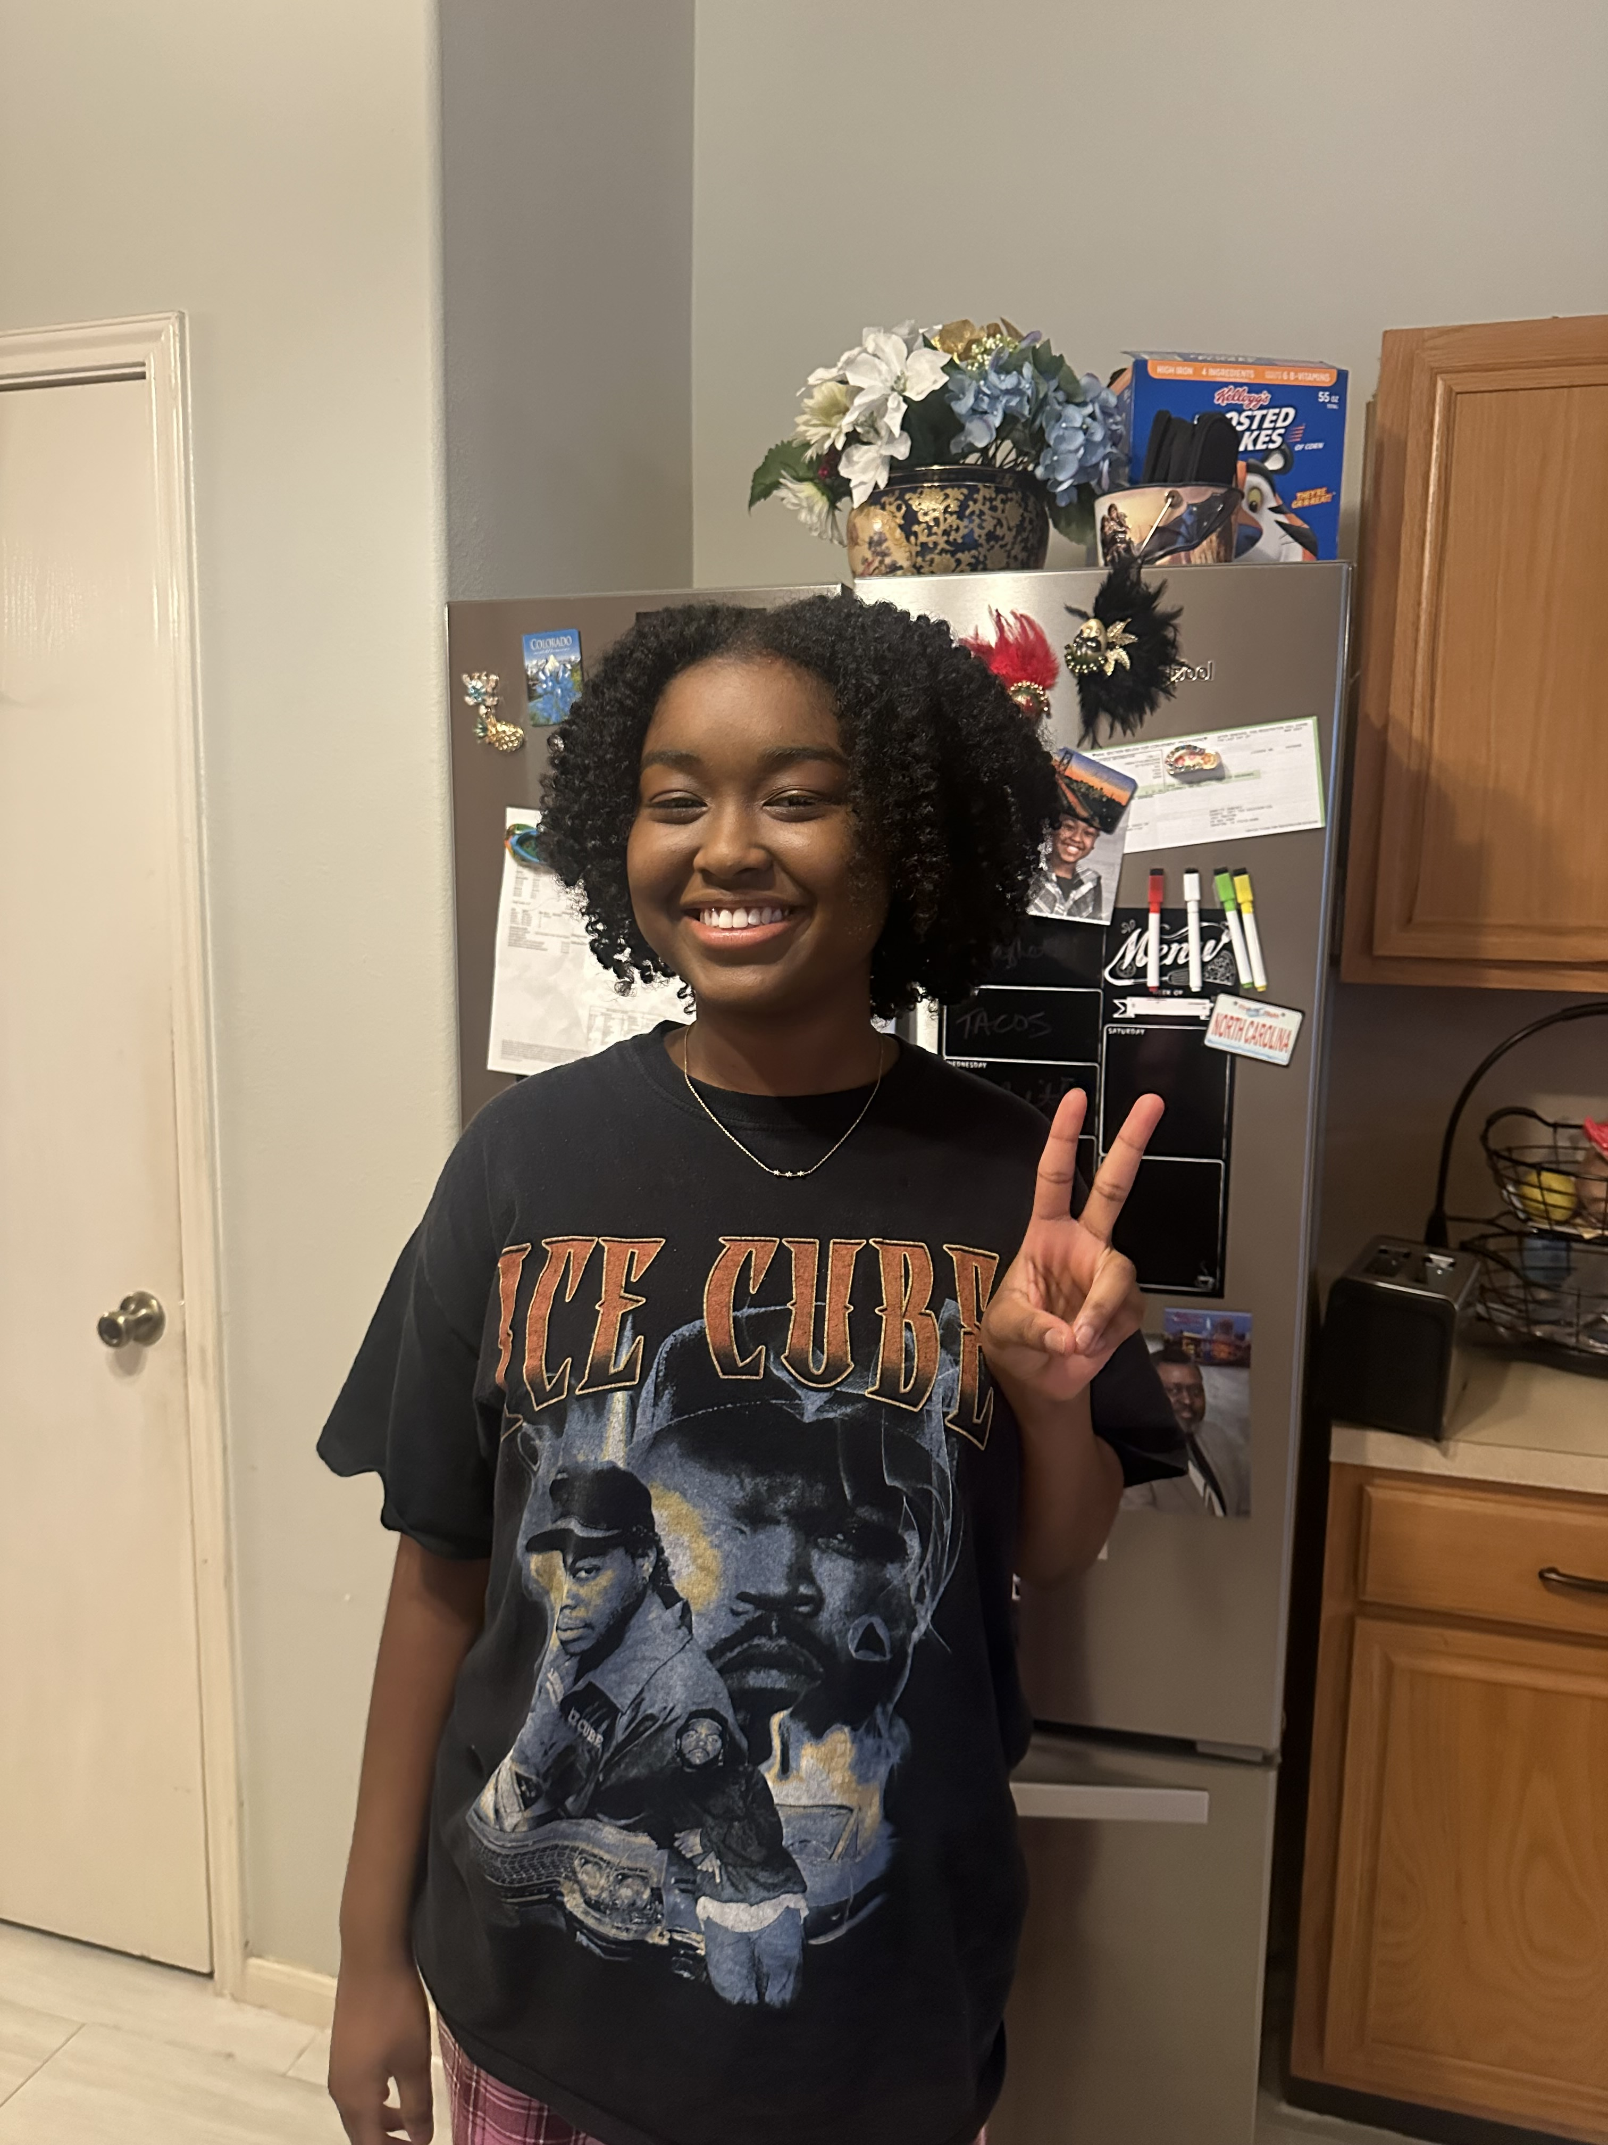
MEET THE TEAM
Nia Calise Lewis
Erran Booker
Dr. Shana D. Lewis
Writer & Producer
Director
Executive Producer
17-year-old Houston-based storyteller, theater student at Kinder HSPVA, and the creative force behind Used to Be.
Visionary director whose cinematic eye and community commitment brings this Houston family story to life.
PhD, LPC, NCC — keynote speaker, leadership consultant & author whose lived experience amplifies this story's impact.

Slide 13
OUR VISION
“Used to Be” is more than a film.
It is a mirror held up to a community
that rarely sees its full humanity on screen.
By sponsoring this film, your brand joins a movement — not a moment. You signal to Black consumers that you see them, value them, and are invested in the stories that shape their lives. This is community investment with real cultural currency.
JOIN US IN BRINGING THIS STORY TO LIFE

Slide 14
LET'S CREATE
SOMETHING MEANINGFUL
TOGETHER
To discuss sponsorship opportunities
for Used to Be, please contact:
Dr. Shana D. Lewis
Executive Producer | Off CNTR Productions
shanadlewis@gmail.com
Used to Be Film | Houston, TX
World Premiere: June 20, 2026 | The Match
© Used to Be Film Production / Off CNTR Productions. All rights reserved.

